Slide 1
Node Package Manager
React Native Camp. - Lecture - 3
`

Slide 2

Agenda:
Node Package Manager
Node.js modules
Singletone in Node.js
NPM recipes

Slide 3
Modules

Slide 4
The module Object
In each module, the module free variable is a reference to the object representing the current module. For convenience, module.exports is also accessible via the exports module-global. module is not actually a global but rather local to each module.

Slide 5
Module exports

Slide 6
Module as singleton

Slide 7
NPM

Slide 8
Local vs Global

Slide 9
Defining your dependencies

Slide 10
Dependencies

Slide 11
Semantic versioning

Slide 12
Publish

Slide 13
NPM commands

Slide 14
Helpful commands

Slide 15
Helpful commands

Slide 16
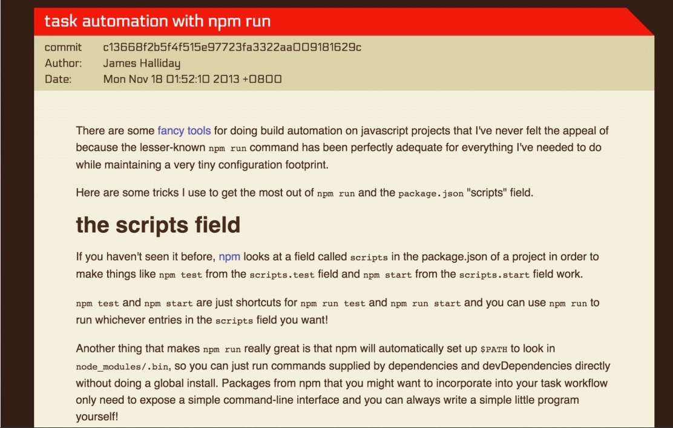
NPM Script

Slide 17
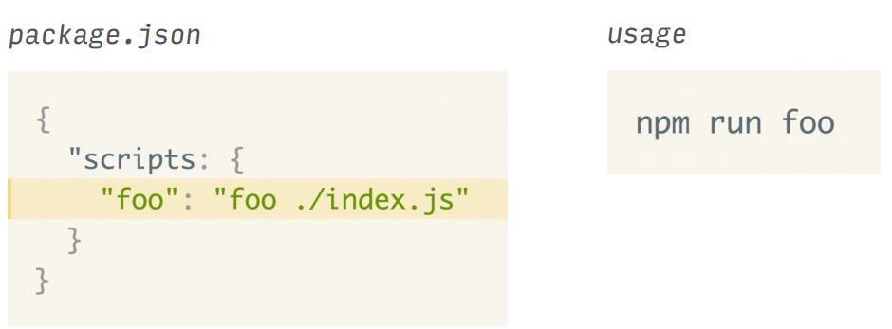
NPM run

Slide 18
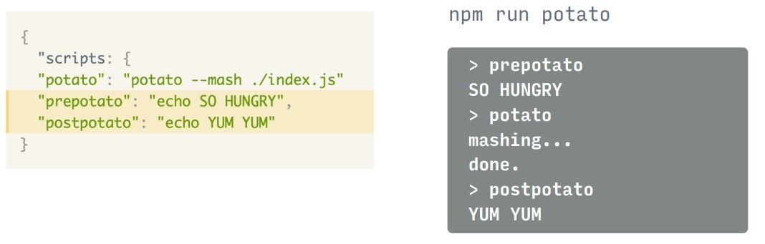
Pre- Post- scripts

Slide 19
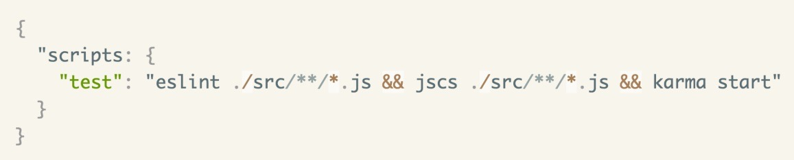
Baseline

Slide 20
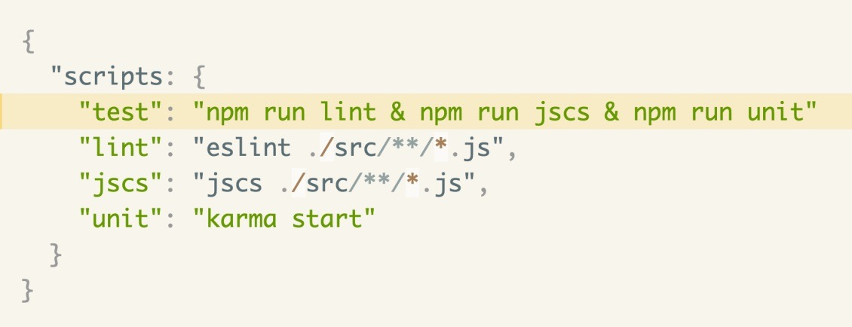
Subtasks

Slide 21
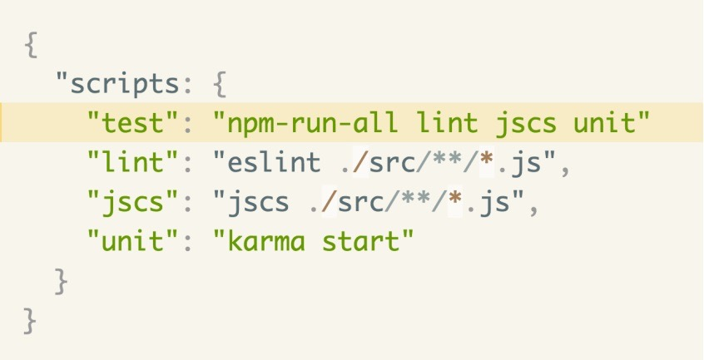
Subtasks with npm-run-all

Slide 22
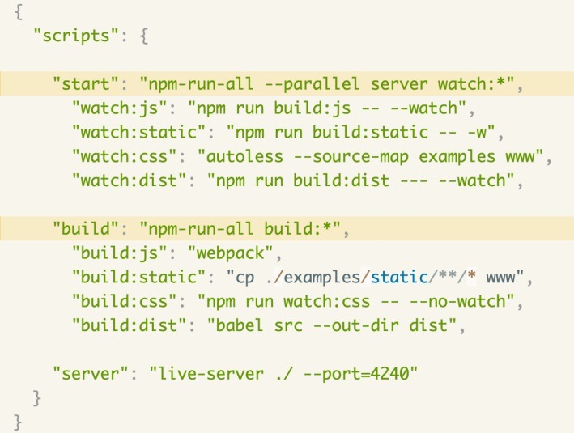
Complete example

Slide 23
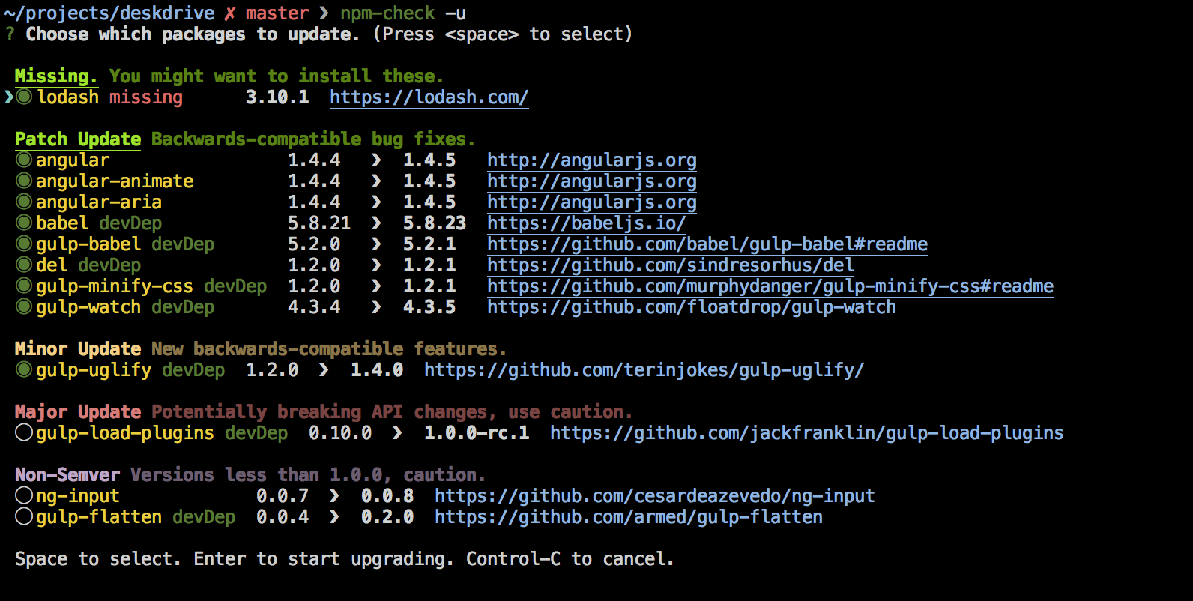
npm-check

Slide 24


Semantic versioning

Slide 25
Thank you for your attention

